Slide 1
HOST BEHAVIOR ANALYSIS
Team Member :-
Nitin Chandra
Pankaj Rai
Somya Gupta
Suhas Bhurse

Slide 2
AGENDA
Introduction
Roadmap
Tools & Technologies
Data Preview
Analysis
Challenges Faced
Future Scope
Conclusion

Slide 3
INTRODUCTION
The project aims to analyze data on property rental hosts to understand how host behavior varies across several metrics.
The dataset includes information on over 20,00,000 hosts, that include parameter like acceptance rate, response rate, instant booking status, profile picture status, identity verified status, review scores, average number of bookings per month, and property type.
The analysis will focus on comparing Super Hosts and other hosts to identify key differences between the two groups. This will include determining the top three crucial metrics required to become a Super Host.
The comments of reviewers will be compared for listings of Super Hosts and Other Hosts to identify any variations.
The analysis will investigate if Super Hosts tend to have larger property types compared to Other Hosts.
The project's findings will help the property rental company understand host behavior better and identify opportunities to improve the host experience.

Slide 4
ROADMAP
PHASE 1
Clean data: Clean the data by removing any errors or inconsistencies.
Explore data: Explore the data to get a better understanding of the distribution of values for each metric.
Compare Super Hosts and other hosts: Compare the key metrics for Super Hosts and other hosts to identify any key differences.
Identify top 3 crucial metrics: Identify the top 3 crucial metrics that one needs to maintain in order to become a Superhost.
PHASE 2
Identify top 3 crucial metrics: Identify the top 3 crucial metrics that one needs to maintain in order to become a Super Host.
Find average values: Find the average values for the top 3 crucial metrics.
Analyze reviewer comments: Analyze the comments of reviewers for listings of Super Hosts and other hosts.
Draw conclusions: Draw conclusions from the analysis.

Slide 5
Tools USED for the project
1
PYTHON
FOR Data extraction ,DATA cleaning & normalizing
2
SQL
Data manipulation and relevant data extraction
3
Excel
DATA visualization and DASHBOARD

Slide 6
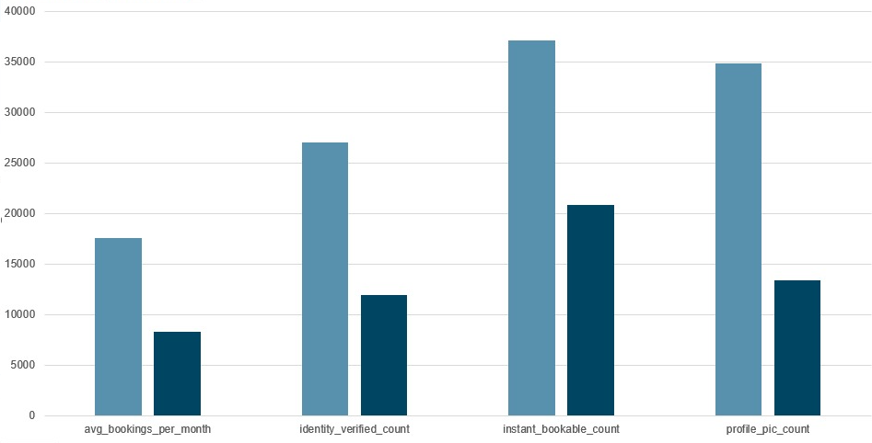
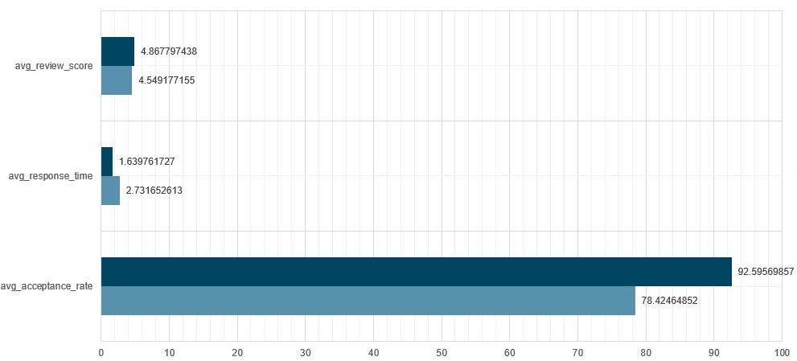
INSTANT BOOKING OPTION
Super Hosts are more likely to have instant booking enabled, a profile picture, and identity verified. This suggests that these factors are important for guests when choosing a listing.
Super Hosts have higher average bookings per month than other hosts. This suggests that they are more successful at attracting guests and filling their listings.
Super Hosts have higher acceptance rates and response times than other hosts. This suggests that they are more responsive to guests and are more likely to accept their booking requests.
Super Hosts have higher average review scores than other hosts. This suggests that guests are more satisfied with their experiences at Super Host listings.

Slide 7
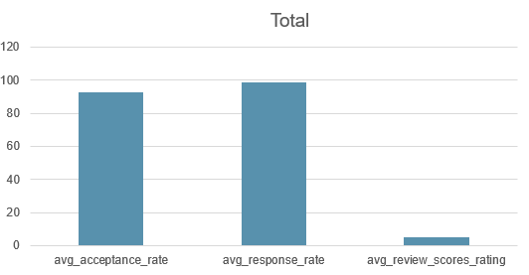
TOP 3 Crucial Metrics One Needs to maintain to become a Superhost are:
Response rate: This is the percentage of time that you respond to guest inquiries within 24 hours. The average response rate for Super Hosts is 98.55%.
Acceptance rate: This is the percentage of guest booking requests that you accept. The average acceptance rate for Super Hosts is 92.59%.
Review score: This is the average rating that guests give your listing. The average review score for Super Hosts is 4.87 out of 5 stars.
If you can maintain these metrics, you will be well on your way to becoming a Super Host.

Slide 8
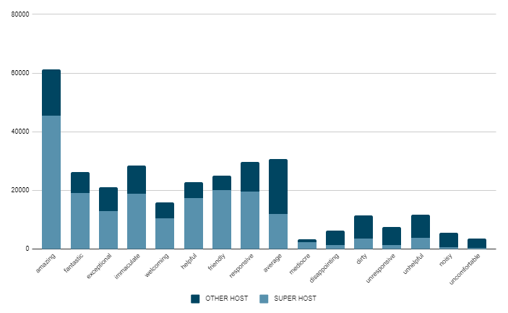
Analysis of Reviewer Comments for Super Hosts v/s Other Hosts Listings
Superhosts receive more positive reviews than other hosts due to meeting strict criteria for maintaining their status.
Superhosts receive more detailed reviews as guests feel more comfortable leaving detailed feedback for hosts who meet higher standards.
Superhosts receive more specific reviews as guests are more likely to take the time to write specific feedback for hosts who meet higher standards.

Slide 9
Positive language:
The reviewers of Super Hosts listings used more positive language such as "amazing," "fantastic," "exceptional," "helpful," and "welcoming" in their comments compared to Other Hosts. This indicates that Super Hosts are more likely to provide an enjoyable and hospitable experience for their guests.
Negative language:
The reviewers of Other Hosts listings used more negative language such as "dirty," "disappointing," "uncomfortable," "unhelpful," and "unresponsive" in their comments compared to Super Hosts. This suggests that Other Hosts may not provide as clean, comfortable, or responsive an experience for their guests as Super Hosts.
Neutral language:
The reviewers of both Super Hosts and Other Hosts listings used similar neutral language such as "average," "mediocre," and "noisy." This indicates that the quality of the experience provided by both Super Hosts and Other Hosts may be similar in some aspects.
Overall, the language used by reviewers for Super Hosts listings is more positive and service-oriented than the language used for Other Hosts listings. This indicates that Super Hosts provide a better overall experience for their guests, which is reflected in the language used by reviewers.

Slide 10
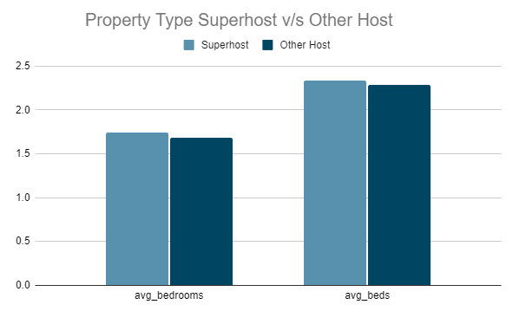
Analysis of Property Type for Super Hosts vs. Other Hosts
Superhosts tend to have slightly larger property types than other hosts.
The average number of bedrooms for Superhosts is ~2 , while the average number of bedrooms for other hosts is ~1.5.
The average number of beds for Superhosts is ~2.5, while the average number of beds for Other hosts is ~2.29.
Possible explanations for this difference include Superhosts being more likely to list larger properties or properties that can accommodate more guests.
It is important to note that the data is based on a small sample size and results may differ with a larger sample.

Slide 11
Here are some other things to consider:
The type of property may also play a role. For example, Superhosts who list entire homes or apartments may have more bedrooms and beds than Superhosts who list private rooms or shared rooms.
The location of the property may also play a role. For example, Superhosts who list properties in popular tourist destinations may have more bedrooms and beds than Superhosts who list properties in less popular destinations.
Overall, the data suggests that there is a trend of Superhosts having larger property types than other hosts. This could be due to a number of factors, such as Superhosts being more likely to list larger properties, or Superhosts being more likely to list properties that can accommodate more guests.

Slide 12
Challenges FACED
Data cleaning. The data was huge and full of noise, which took a lot of time to clean and extract relevant information. This was a major challenge because it slowed down the process of analyzing the data and making decisions.
Language translation. Some of the comments were in different languages, which made it difficult to understand the feedback. This was a challenge because it was important to get the full context of the feedback in order to make informed decisions.
Currency conversion. Some of the prices of the properties were in local currency, which had to be converted into USD. This was a challenge because it was important to get the accurate price of the properties in order to make comparisons.
Data visualization. The data was complex and difficult to visualize. This was a challenge because it was important to be able to see the data in a way that made sense in order to make informed decisions.

Slide 13
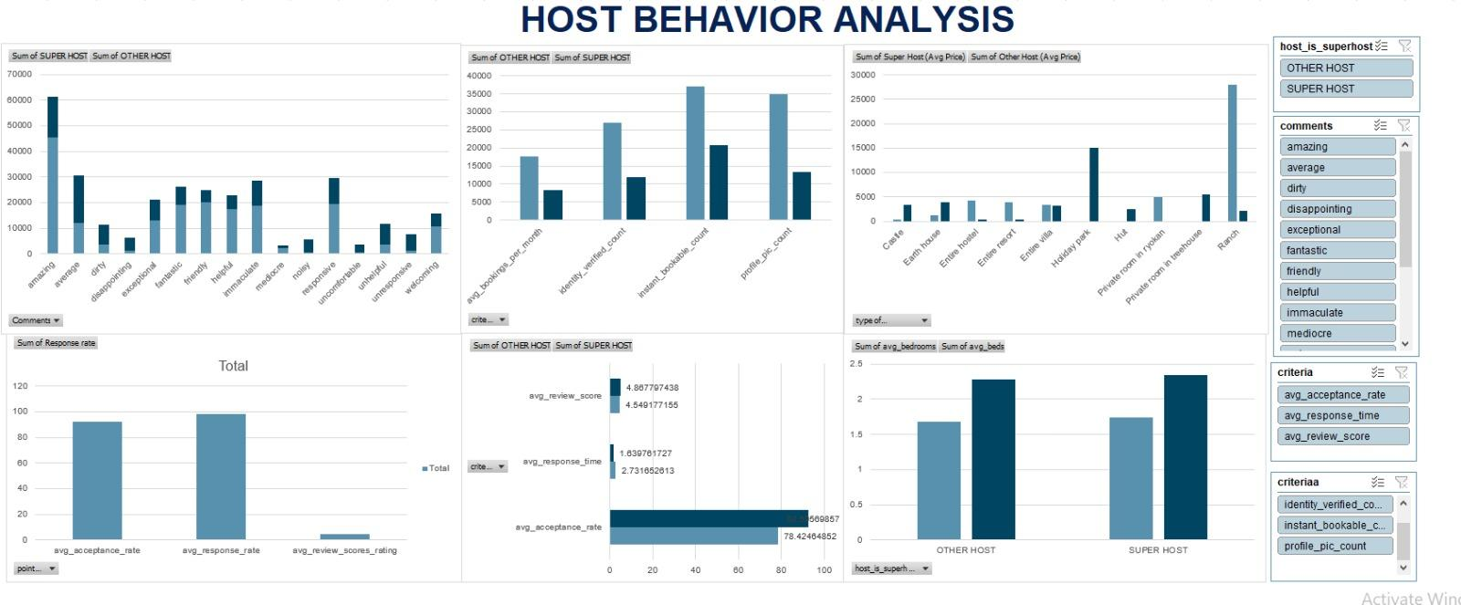
DASHBOARD

Slide 14
FUTURE SCOPE
Some future scopes that can be derived from the DATA:
Hosts can improve their chances of becoming a Superhost by increasing their acceptance rate, response time, and review score. They can also improve their chances by listing larger property types, getting their identity verified, and making their listings instant bookable.
Guests can improve their chances of having a positive experience by booking with Superhosts. Superhosts are more likely to be responsive, provide a high level of service and quality, and have larger property types.
Airbnb can improve its platform by making it easier for hosts to become Superhosts and for guests to book with Superhosts. This could be done by providing more resources and support for hosts, and by making it easier for guests to find and book Superhost listings.

Slide 15
CONCLUSION
Superhosts are recognized as being more successful than other hosts on Airbnb. They tend to exhibit higher acceptance rates, faster response times, better review scores, and receive more bookings per month. Furthermore, they are more likely to have their identity verified, be instant bookable, and have a profile picture.
There are several key factors that contribute to the success of Superhosts. They are typically more responsive to guests, offer a higher level of service and quality, and have larger and more professional properties. In addition, they are perceived as being more trustworthy and reliable.
For hosts looking to achieve Superhost status, it is advisable to improve their acceptance rate, response time, and review score. Additionally, they can increase their chances by offering larger properties, completing their identity verification, and making their listings instant bookable.
Guests can benefit from booking with Superhosts, as they are more likely to receive a responsive, high-quality experience with larger properties.

